Slide 1
Chat Relay – Design Phase
By: Kenny Kottenstette, Talhah Shaik, Zoheb Sharif

Slide 2
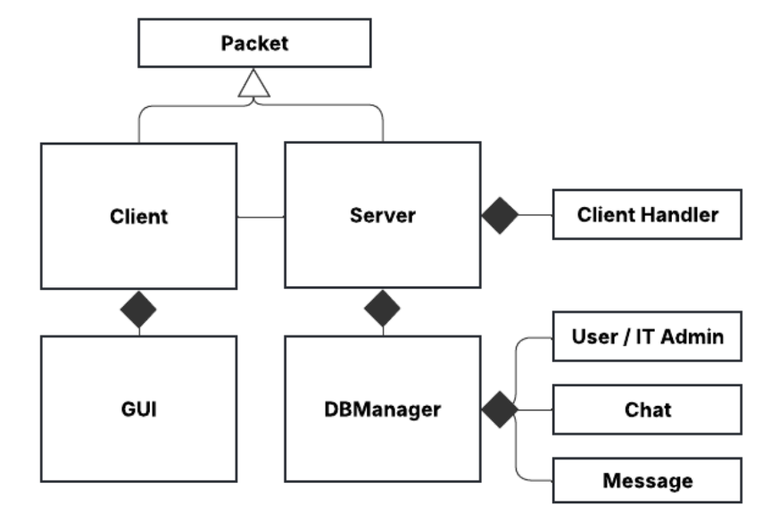
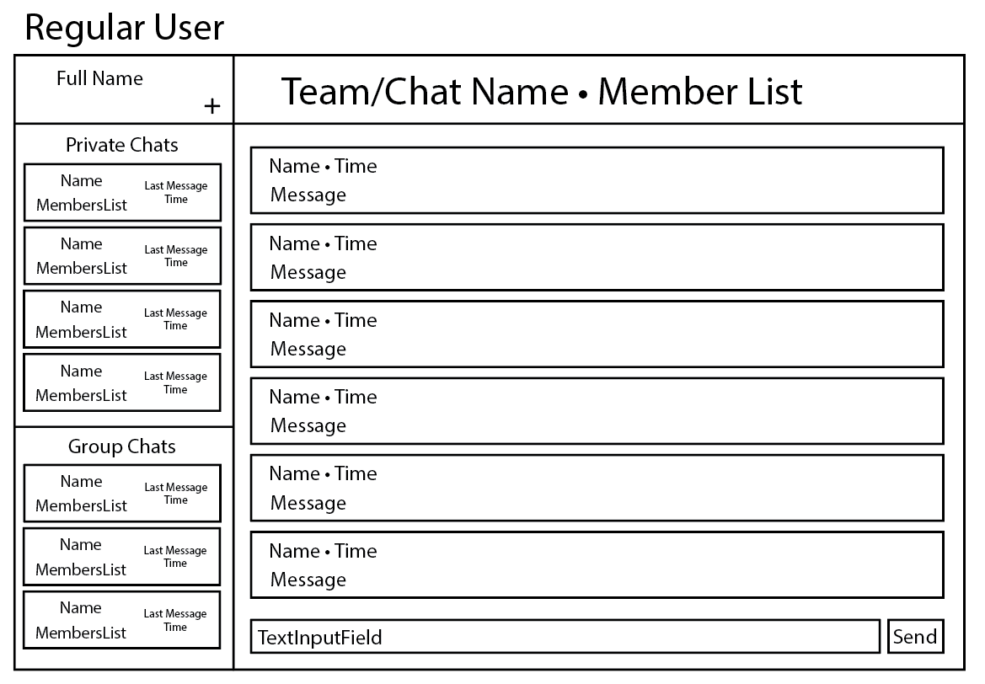
Class Descriptions Through Prototype

Slide 3
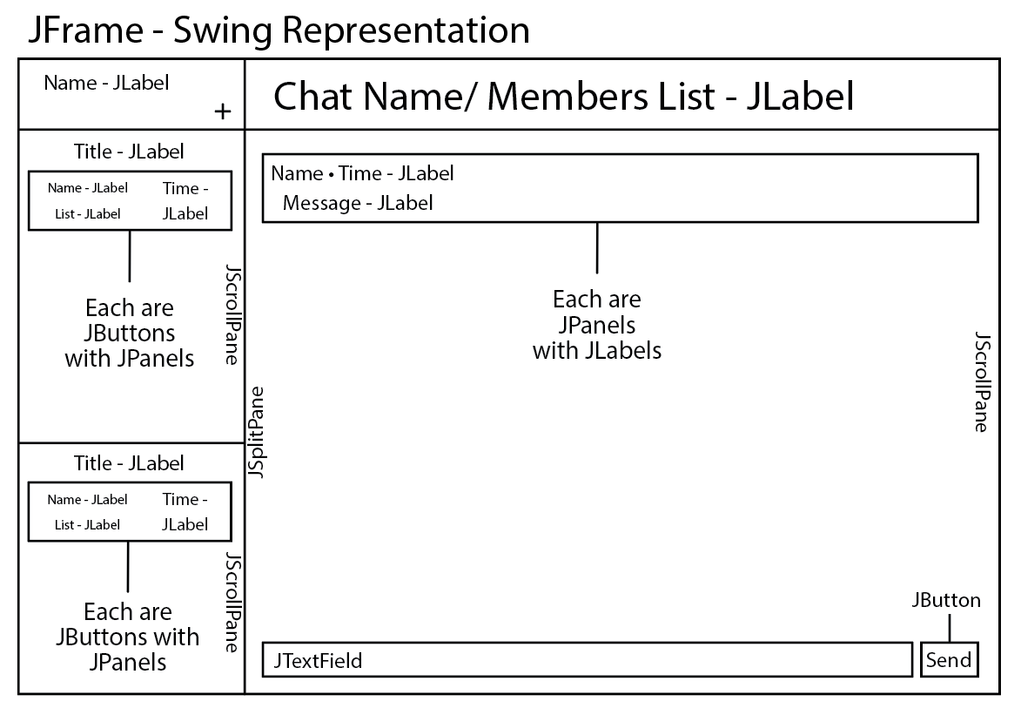
JPanel – a section of the GUI for elements to be added
Left Panel, Right Panel, Input Panel, Chat Panels
JSplitPane – A split pane to separate the left and right panels
JScrollPane – Scrollable objects
Private Chat Scroll, Group Chat Scroll, Messages Scroll
JLabel – Text boxes on the frame
Name Label, Chat Label, Members List Label, Time Label, Message Label
JButton – Clickable buttons that do a set of actions once pressed
Send Button, Chats Button
JTextField – Input fields for text
Message Field
GUI Description

Slide 4
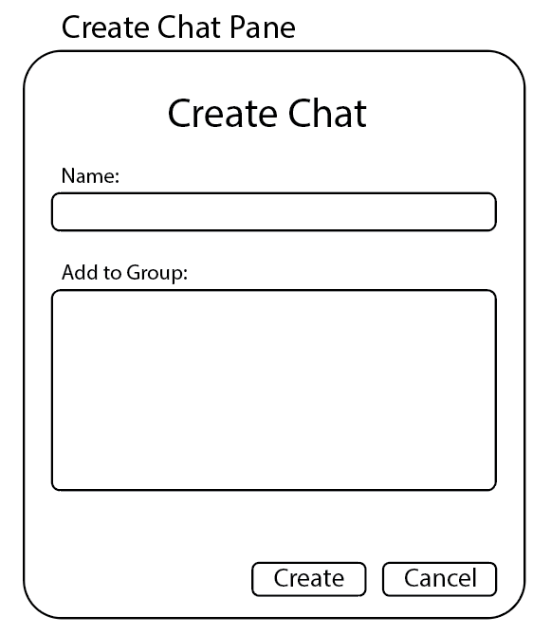
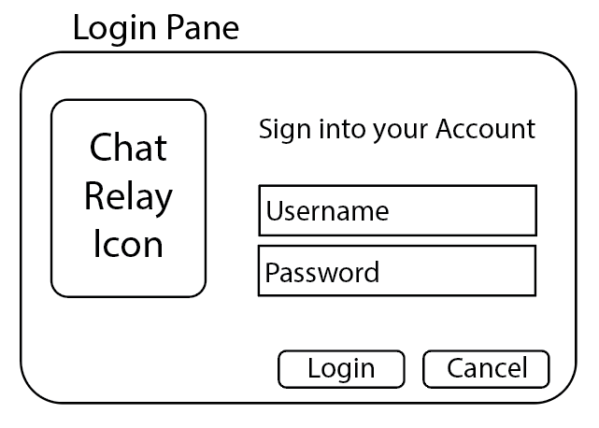
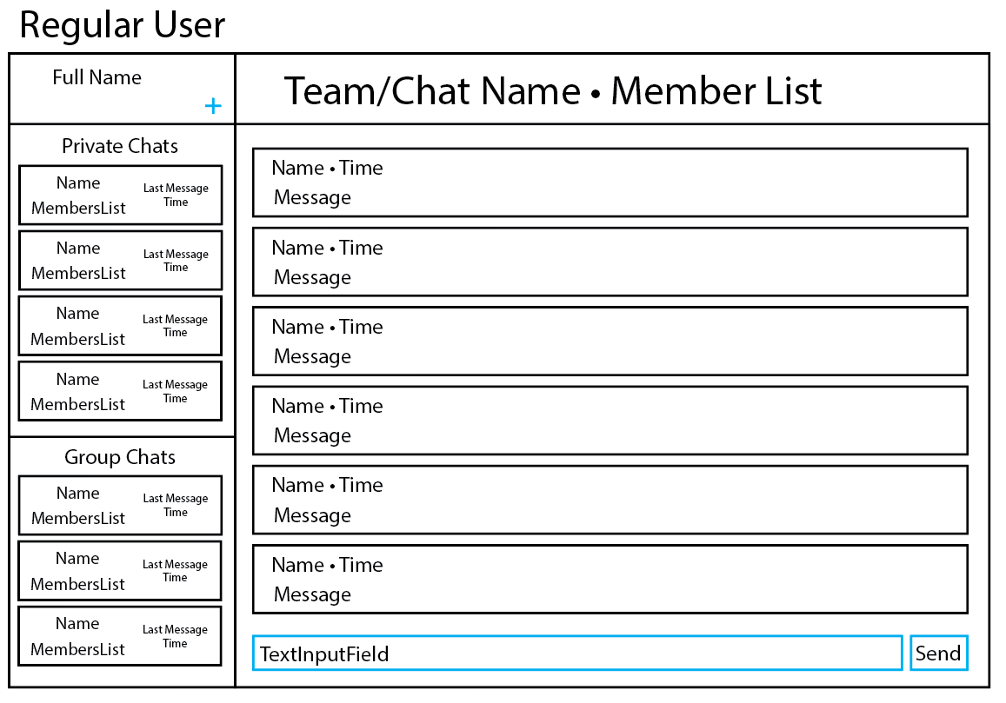
Client Description
Login - Authenticated user based on provided credentials
SendMessage (Blue) - Sends a message to specified chat.
CreateChat (Blue) – Creates a new Chat with selected Users
UpdateState - Refreshes client’s current data and connection status.
Logout – Logs the User out and closes the session

Slide 5
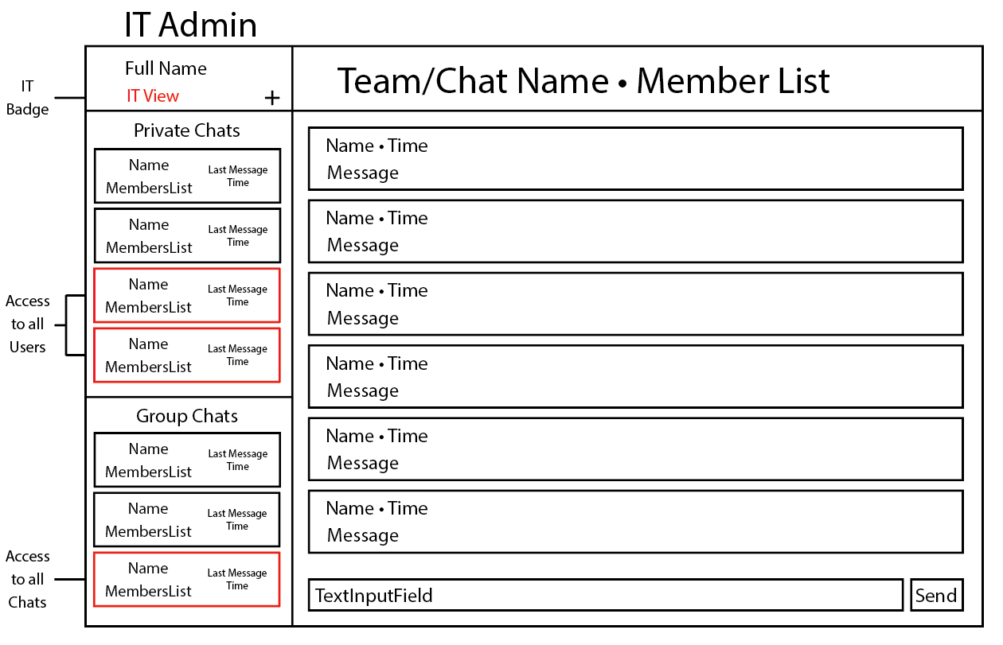
User / IT Admin Comparison

Slide 6
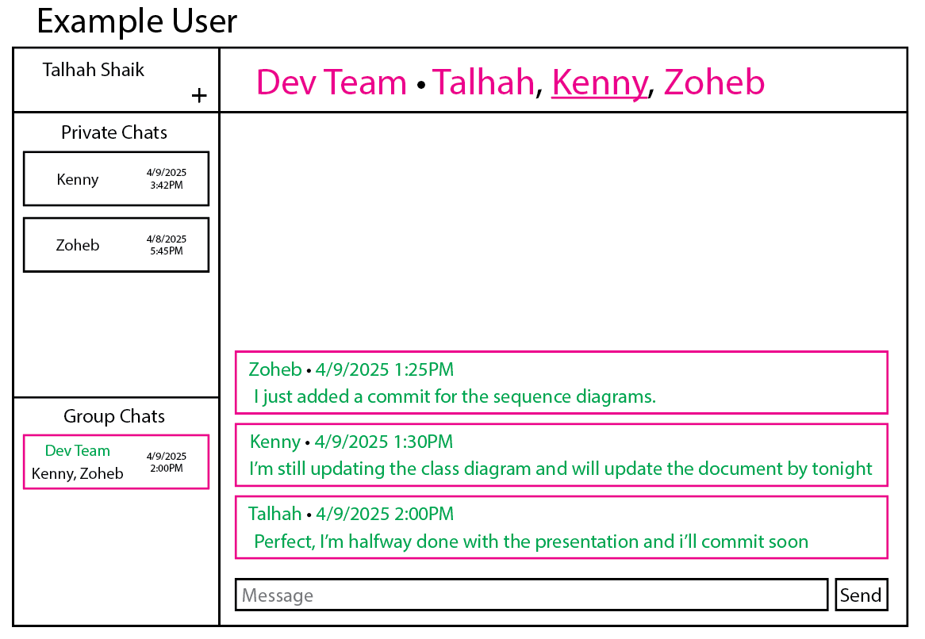
Chat / Message Descriptions
Chat (Magenta):
Messages – A collection of messages in the chat
Owner (Underline) – The User who create the Chat
RoomName – The Chat name to be displayed
Chatters – A List of Users in the Chat
Message (Green):
CreatedAt – Current time the Message was created
Content – The text being sent
Author – The original sender
Chat – The Chat where the Message is being sent

Slide 7
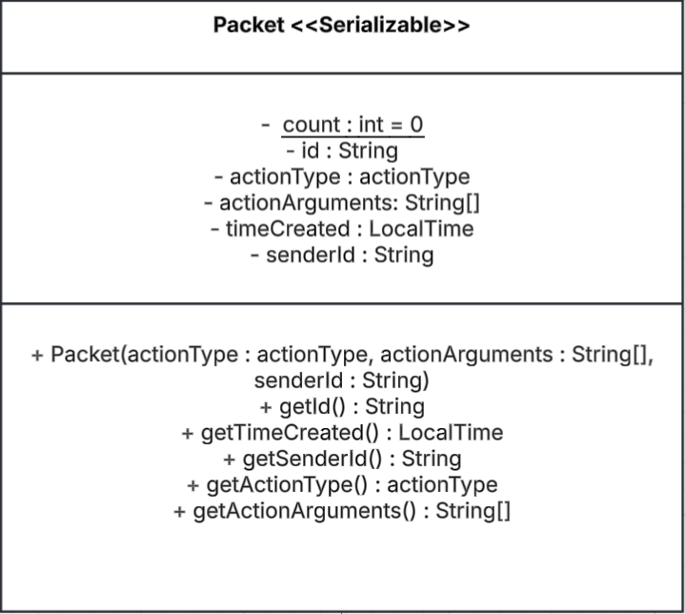
Packet Description
ActionType - Tells the purpose and ultimately how the Packet is supposed to be processed.
TimeCreated - Time the packet is created
SenderId - Denotes who created the packet
ActionType <<Enumeration>>
LOGIN SEND_MESSAGE
GET_ALL_CHATS GET_ALL_USERS CREATE_CHAT
SUCCESS
ERROR
CREATE_USER ENABLE_USER DISABLE_USER

Slide 8
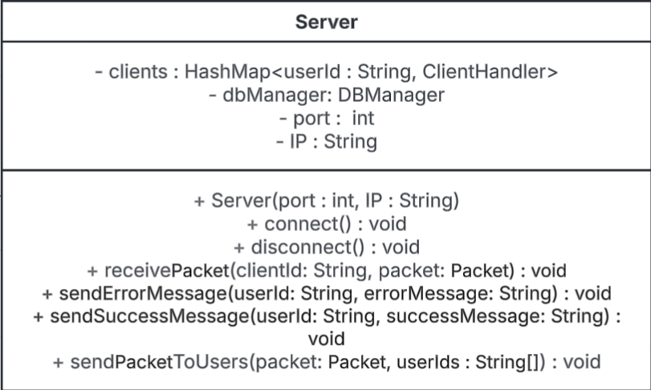
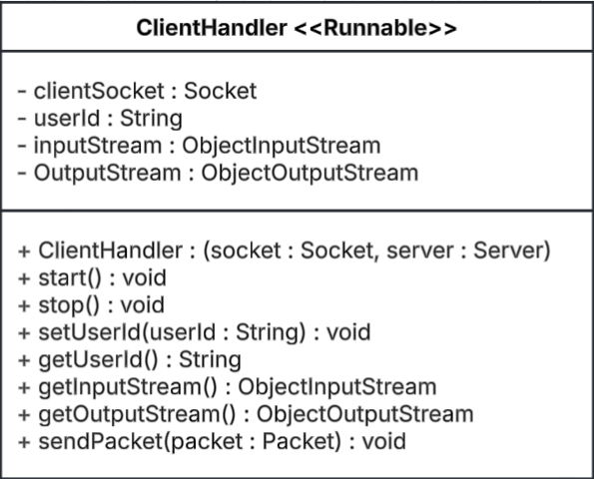
Server / Client Handler Descriptions

Slide 9
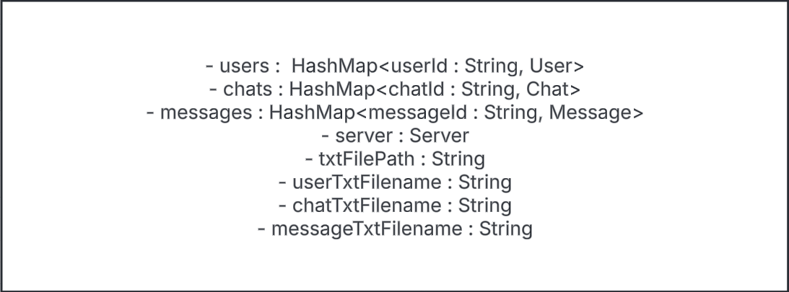
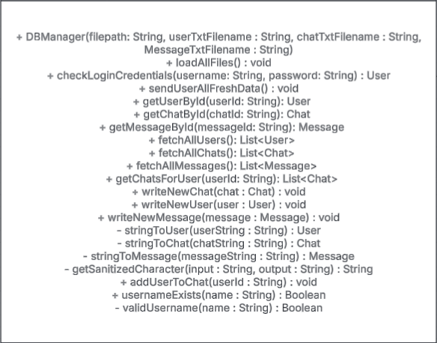
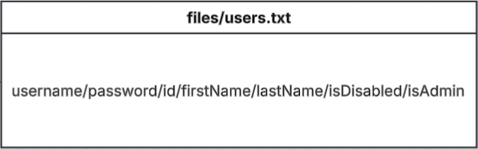
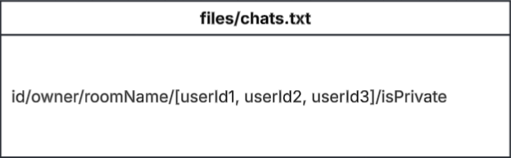
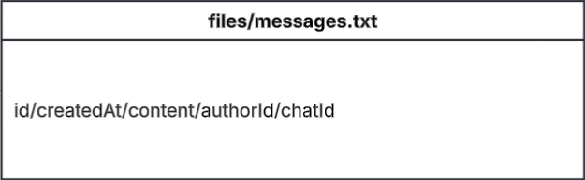
DB Manger Description
Attributes
Methods
Files

Slide 10
Thank you

